Slide 1

Managing a Technical Team in a Hybrid Work Environment
11 / 1 / 2021
Team Three for All
Matt Tressler
David Kelly
Neal Bradshaw
We commit ourselves to Washington State University's high standards to uphold academic honesty and scholarly values as established by the WSU's Standards of Conduct. We affirm that we have not given or received any unauthorized assistance on this assignment/examination, that the work product presented here is the work of the authors [all team members listed], and that all materials from other sources (including books, articles, Internet, or other media), whether quoted or paraphrased, have been properly cited.
Matt Tressler, David Kelly, Neal Bradshaw
Notes:
(MATT)

Slide 2

Managing a Technical Team in a Hybrid Work Environment
Research Goal
Research challenges and solutions that come with managing a technical team in a hybrid workplace.
Team Inclusion
Team Building
Communication Challenges
Setting Team Expectations
Notes:
(MATT)
Objectives of Project
The objective of this project is to understand the biggest and most common challenges managers have experienced associated with switching to a hybrid workplace. Then research and report solutions and tools used to address these challenges.
Justification
This is relevant for people today. This is also a new phenomenon. The technology has only become viable in the past 10 years and allowed for a global workplace with high quality video conferencing and real time file sharing. The COVID 19 pandemic made a virtual workplace a necessity for a lot of companies. Companies are now committing to a hybrid work place indefinitely to attract the best talent.
People have also been in vastly different situations over the past year and a half: limited or no childcare or are managing their kids’ online school. Folks have health issues that preclude them from returning to in-person work. Some personalities are eager to get back in the office and others are content to work from home forever. Still others are hesitant to return due to Covid-19 vaccinations or lack thereof. This research project will tackle these issues.

Slide 3
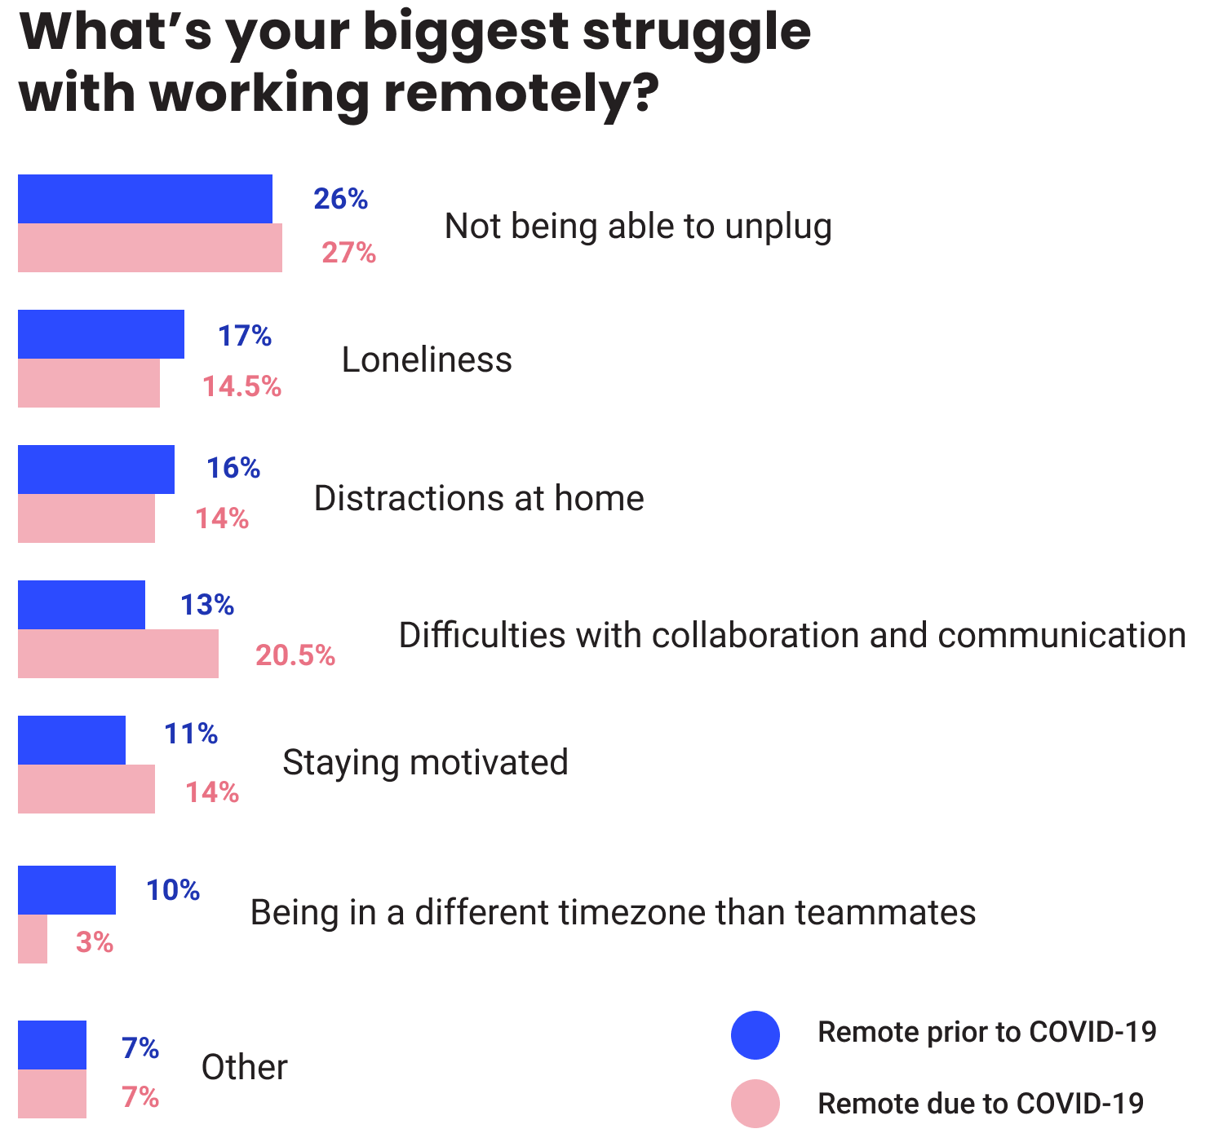
Remote Communication Challenges
Chart #12 from reference [9]
Notes:
(NEAL)
Almost a quarter of all struggles working remotely is communication related
Sharp increase after covid.

Slide 4
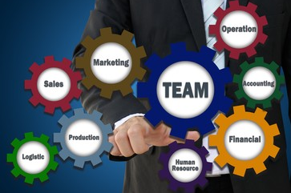
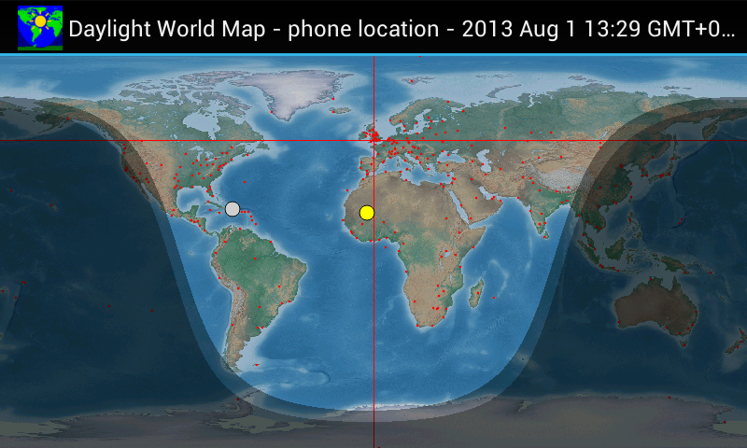
Team Communication Challenges
What are some of the communication issues teams encounter with remote work:
Different Geographic / Time Zone Locations
Work Schedules
Meetings
Weather or other localized issues
Different Cultures / Languages
Clear communications
Translation
Different Department / Technical Expertise
Understanding technical concepts
New communication tools
Setting up contracts and other official documents
Different Priorities
Communications
Building trust / following schedules
Notes:
(NEAL)
Different Geographic / Time Zone Locations
Work Schedules – Peoples work schedules vary for multiple reasons such as their physical locations and time of day. All parts of the world are not on the same schedule.
Meetings – Finding times that work for everyone to be available for meetings. Not being an active participant and watching recordings later can cause issues in completing meeting objectives
Weather or other localized issues – Power outages, extreme weather, communications black outs are rare, but possible problem that could pop up an inconvenient times.
Different Cultures / Languages
Clear communications - Agreements need to be made on communication language and address any potential cultural issues
Translation - If work needs to be translated for team, who will complete the work. Do they understand both languages to do proper translating? (Google Translate works, but meanings can be skewed)
Different Department / Technical Expertise
Understanding technical concepts – People are at all different levels of understanding and utilizing technology. What is easy for one can be extremely difficult for another.
New communication tools – Old ways to communicate to Team members is not able to be done in the same method anymore and a new communication method needs to be established. An example would be building a working prototype where everyone could hold it and see how it works, where now a video or some other communication is how they can see it work.
Setting up contracts and other official documents – anything that needs to be signed or needs legal documented approval. Electronic signatures and other software need to be available to document these transactions.
Different Priorities
Communications – How much and how often. Employees with different priorities and different backgrounds require different amounts of communication to reach their objectives. Knowing when there is to little or too much can cause issues for the productivity of employee's. Unnecessary meetings can also eat up employee's time.
Building Trust / Following schedules – With a loss of visibility seeing Teams progress on project, the schedules need to be closely monitered to achieve the project goals. Building trust that the work of others will be done on schedule is key to meeting the deadlines for the team.

Slide 5
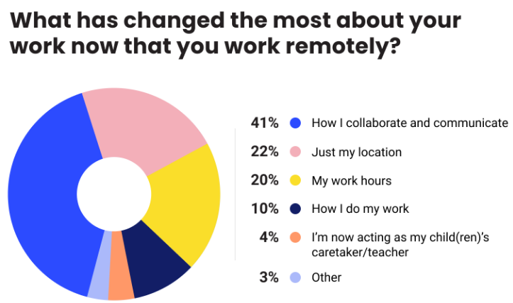
Remote Communication Challenges
What communication areas are most likely to be lost by remote working? What are some possible solutions?
High Band-Width Sharing
(Face-to-face communication including non-verbal and supplementary communication from multiple senses)
Passive Knowledge
(Knowledge that is not directly communicated to you)
Casual conversation
(Water cooler talk)
Immediate Responses
(Time dependent conversations)
Verbal Commendations / Reinforcement
(Accolades)
Chart #8 from reference [9]
Notes:
(NEAL)
High Band Width Sharing (Face to face communication including non-verbal and supplementary communication from multiple senses)
Video meetings with cameras on
Recorded videos with illustrations or live speakers that can be accessed
Passive knowledge (things that are not directly communicated to you)
Things overheard or conversations that are casual in nature and are not normally structured or documented
Encourage adding other potential insights into communications with other individuals
Ask curiosity questions to other Team members can respond to.
Casual conversation (water cooler talk)
Places where conversations not related to work to happen to build relations on the team
Watercooler rooms can be put together where people can log in and chat during lunches and other breaks
Integrated one-on-one messaging built into productivity software
Immediate Responses (Time dependant conversations)
Delays and other interruptions can produce setbacks on progress.
Ideal Check-ins for others communications can allow other team members know about when they should receive a response.
Verbal Commendations / Reinforcement (Accolades)
Many of the Accolades that typically used to happen are forgotten about such as work anniversary, birthdays, reinforce possitive successes and individual achievements.
Take time to celebrate these achievements still in chats, meetings, or check ins.
Use regular communications sent to everyone to recognize the achievements.

Slide 6
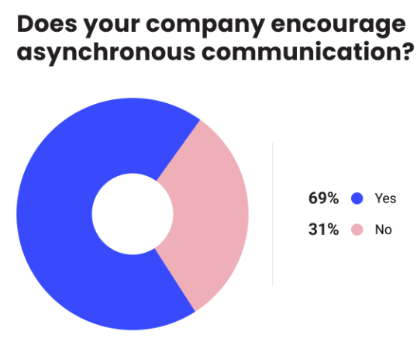
Remote Communication Challenges
How do managers select the best communication methods and technology platforms?
Project Management software best for the Team's project application
Remove any communication barriers.
Schedule blocks of time for communication meetings
Address deficiencies that cause communication issues
Utilizing Asynchronous Communication (Email, Collaboration Documents, and cloud technologies)
Develop a Procedure and expected Communication Criteria
Utilize technology that employees have been properly trained to operate
Support Structure
Chart #20 from reference [9]
Notes:
(NEAL)
Project Management software best for the Team's application – Many options available on the market with different features. Need to be selected for criteria specified for project.
Remove any communication barriers.
Schedule blocks of time for communication meetings. This gives team members knowledge of when you can be reached. They know when you will be the most accessible
Be aware of deficiencies previously discussed and address them from the start.
Utilizing Asynchronous Communication (Email, Collaboration Documents, and cloud technologies) All of these allow work to be done 24 hours a day and can keep others up to date on the work status when they are not working.
Develop a Procedure and expected Communication Criteria - Know what is expected of each individual when receiving or sending a communication. It keeps everyone on the same page of what is being communicated. Expected responses can be conveyed too. “Four Hour Response (4HR)” and “No Need to Respond (NNTR)” are examples of response requirements that could be added to the end of a communication.
Utilize technology that employees have been properly trained to operate. Various skill sets and knowledge need to be gained by offering training and support for team members.
Support Structure- Have a go to method to get individuals in contact with experts / managers to solve problems or issues that arise and they cannot solve.

Slide 7


Communication Challenges
How can teams address technical issues for remote working?
Be clear on who is providing parts of infrastructure / tools that are needed
Early in transition to remote work, plan extra time to fix problems.
Virtual or online training on use of software and hardware for using remote communication tools
Hiring IT support
Cyber Security
Company provided equipment
Guarding against electronic attacks
Notes:
(NEAL)
Be clear on who is providing parts of infrastructure / tools that are needed. Make sure what features are needed or security measures are included. Who is providing the tools and paying for them, the company or you.
Early in transition to remote work, plan extra time to fix problems. There is a learning curve in the transition from in person to remote work on teams. It is a new skill set.
Virtual or online training on use of software and hardware for using remote communication tools - Knowledge of using the systems can make sure that critical information is not lost due to an individuals lack of understanding how to use the software or hardware.
Hiring IT support - Have a department or method to get individuals in contact with experts to solve problems or issues with software or hardware.
Cyber Security
Company Provided Equipment - Provide individuals with the correct options and hardware needed to connect securely with others on the team. Good audio and video inputs and outputs can help with clear communication
Guarding against electronic attacks – Using a VPN and Antivirus software guards against Virusus, Malware, ransomware, and phishing.

Slide 8


Team Building
How do team leaders ensure that they are building a strong team in hybrid environment?
Scheduled Check-ins
Video meetings and group communications
Include everyone
Create Team-Building Activities
How do team leaders maintain a team as it transitions to a hybrid workplace?
Find a suitable Project Management Tool
Build an Environment of Trust
Still have occasional physical meetings
Notes:
(NEAL)

Slide 9
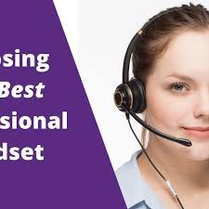
Team Inclusion
How do managers make sure everyone is included in a hybrid workplace
The employee experience should be the same if you are in the office or virtual.
Hold regular meetings. Reg meetings help virtual workers feel important.
All should connect to the meeting virtually. This helps to hear all comments, and avoids whispers
Have great audio equipment or each have a headset. So you can pickup quiet voices in the room
Avoid meeting after the meeting. this is where you ask someone for clarification, try to include everyone in those conversations.
Notes:
Reg meetings help remote works feel important.
Unless you have great equipment, all should use head sets, otherwise, you miss some comments
MAM – this is where sometime significant details or clarification occur, include everyone. Don't wisper, or notes

Slide 10
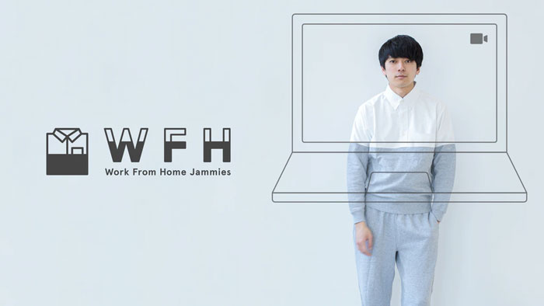
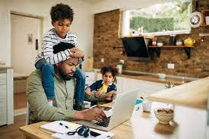
Team Inclusion
How do managers ensure engagement
Encourage all employees to turn on their video. Video encourages us to be more professional. It picks up verbal and non-verbal and helps us shift gear into working mode.
Dress for success. Many studies show that the way you dress up is correlated with your productivity levels
Get out of your pajamas! It can affect productivity. You feel better when you take a shower, put on some colon or makeup.
Encourage team to stay focused. Set up a home office so you can shut the door. Eat lunch in the kitchen
Allow each person a chance to talk. Ask the shy ones. Ask if there is anything else to discuss. You may go over time limit to get all comments in. Be intentional about balance each persons time.
Notes:
shirking the responsibility of getting dressed could actually have a negative impact on our productivity, sleep patterns and, perhaps most significantly, our mental health. It helps us mentially shift gears into working mode. Many studies show that the way you dress up is correlated with your productivity levels.
Stay focused by setting up a home office so you can shut the door. Eat lunch in the kitchen
Ask people if there is anything else to discuss. You may go over time limit to get all comments in. Balance

Slide 11

Team Inclusion
What is the role of a manager
A hybrid environment requires a manager to be fully supportive and understand the differences between remote workers and on-site workers.
The manager must continue to apply rules fairly to everyone. how and when to communicate and collaborate. Have clear communication channels for contacting team leaders, setting rules for when to begin and end their day, if flexibility is offered
The manager must reach out since employees can be are under immense stress. Have conversations with colleagues at the office and one-on-one video calls with your remote workers to help with stress
Avoid the “us versus them” mentality. Try to be consistent with both teams
Manage time zones. make sure meeting are not at 11p or 6a in a remote location
Setup a system to allow easy collaboration such as MS teams. Activity feeds, calls, meetings, quick questions. A lot more.
Notes:
Apply rules fairly - how and when to communicate and collaborate with colleagues. clear communication channels for contacting team leaders, setting rules for when employees can begin and end their day if flexibility is offered, and defining the times that employees are expected to respond to communications.
It’s incumbent on you to reach out. Have socially distant conversations with colleagues at the office and one-on-one video calls with your remote workers.
Time zones – make sure meeting are not at 11p or 6a in a remote location
Us versus them - There could also be the same kind of communication, team engagement, and coordination issues that are common with geographically distributed teams

Slide 12
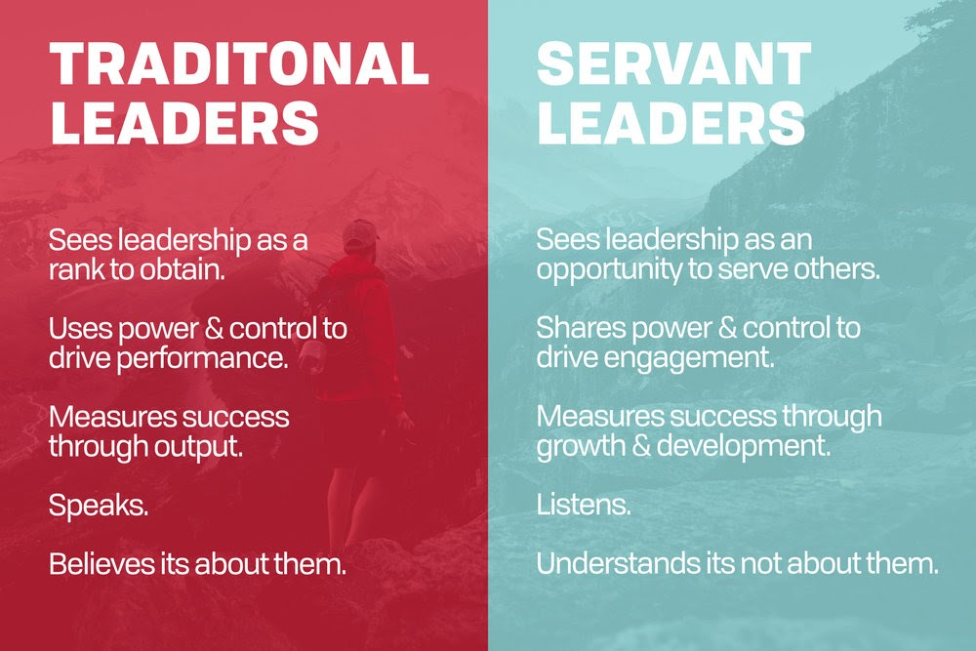
Team Inclusion
What leadership frameworks perform best in this environment
Servant leaders are excellent listeners and overall communicators and communication is very important in hybrid environments.
Serves others. Makes others feel good and brings a message that you care. Takes a load off of team. Doing tasks they don’t like to do.
Shares power & control to drive engagement. Give others a chance to run the meetings and do special projects
Measures success via growth & development. Help them grow and improve
It's not about them. They are trying to put others first
Strong with emotional intelligence. matt beeton he called it the X factor
Connect with people
Vision + action can change the world
Passion and enthusiasm
Notes:
S Leader: Serves others, shares power, measures success, not about them. Empathy.Healing.Awareness.Persuasion.Conceptualization.Foresight.Stewardship.
Emotional intelligence – From the ted talk from matt beeton he called it the X factor
Connect with people
Vision + action can change the world
Passion - enthusiasm

Slide 13

Setting Team Expectations
Have work hours changed?
Hours and days should remain flexible – days in the office and remote. Have core hours and meetings but allow flexibility
Be sensitive to diversity and inclusion. Some workers might go 100% remote due to bus routes and child care.
Consider a rotating schedule for onsite vs remote to connect with some face time. This can affect promotions since you need to have a connection with management. Managers tend to promote those who they have good relationships with. Face to face give sense of belonging, builds relationships. Onsite you can go to lunch and develop friendships which bond the team.
Keep in mind the time zone issues.
Consider keeping leadership out of the office to avoid bias against remote workers. Interesting idea keeping leadership out of the office. May not always be possible but could avoid bias
Notes:
D-I – some workers might go 100% remote due to bus routes and child care.
The rotating schedule might help. each employee sees all of their coworkers in person within six business days. This can help foster a sense of belonging, as everyone will get face time with each other and connect in a way that they can’t do over video chats. It’ll also mean they have a physical space that can anchor and ground them—a work home, if you will—even if it’s only a couple of days a week.
Rotate so you have a connect with management. Managers tend to promote those who have good relationships with.
Interesting idea keeping leadership out of the office. May not always be possible but could avoid bias

Slide 14
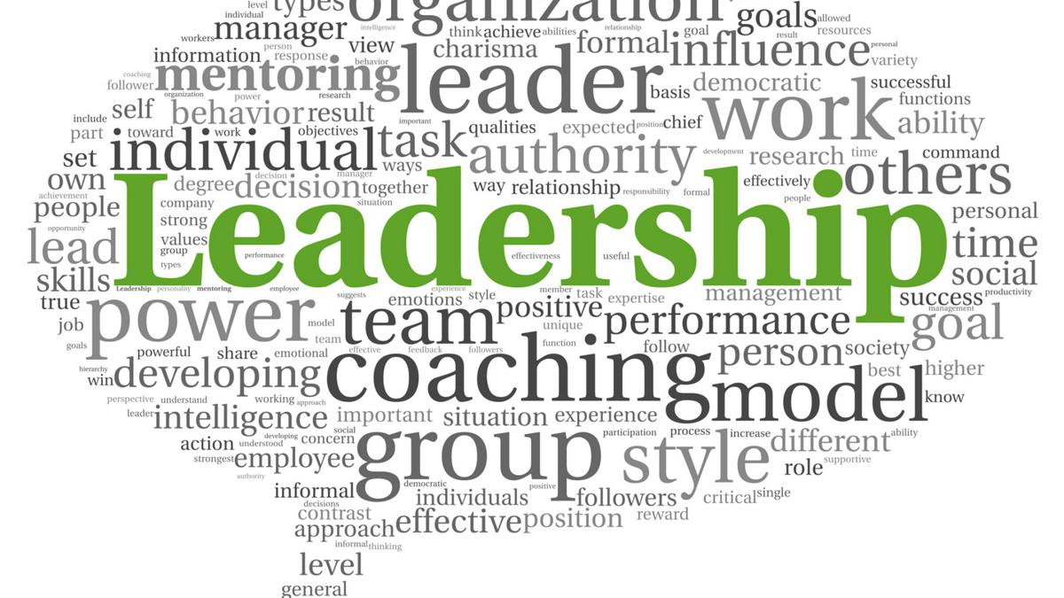
Setting Team Expectations
How does leadership drive expectations?
By setting the example. Your team will follow your lead.
Foster communication practices for status, time-off, contact information are important. Have a system for these items.
Treat everyone with respect.
Acknowledge each person's dignity.
Have empathy for a life situations
Listen others opinions and input.
Validate their contributions.
Avoid gossip, teasing and other unprofessional behavior.
Get to the meeting first. You could stop the meeting at 5 or 10 minutes from end to allow time to get to the next meeting.
Everyone should have a plan to grow using goals including the manager. Goals every 6 months or sooner. Yearly goals are too far out in my opinion.

Slide 15
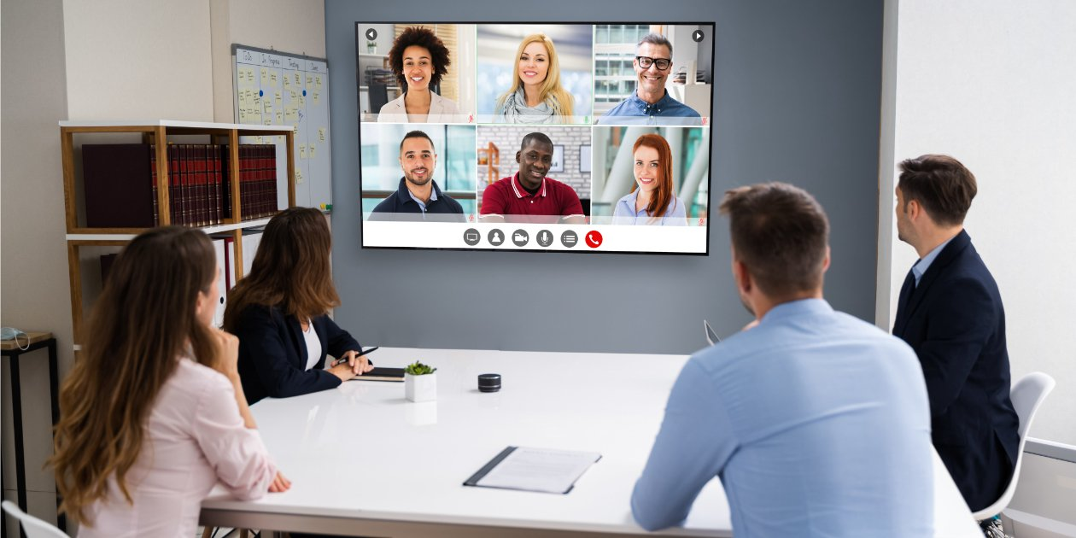
Setting Team Expectations
How do hybrid teams collaborate to achieve a common goal?
One of the biggest hurdles affecting hybrid work is effective collaboration. be clear on important work principles and implement them within the team. Such as…
Know the deadlines and agree to them
Have equal access to the manager. Such as a 1 on 1 scheduled meeting each week or bi-weekly.
Have clear expectations on your availability response times. When to response to chat?
Interpersonal relationships need to flourish. We talked about having a rotating schedule but also having online events such as happy hour or games. Or schedule an event at a park.
Notes:
You spent months and years crafting a style of in-office collaboration and you don’t want to throw that all out now that you have a hybrid workforce. You will need to get clear on important work principles and strive to both implement them within the team and embody them as a leader.

Slide 16
Professional Interviews – Methodology
Interview Panel
Communication - What are the biggest communication challenges you have faced with your team going to a hybrid workplace? What are the best ways you found to overcome those challenges?
Team Building - How do you ensure you are building/maintaining a strong team chemistry in a hybrid workplace?
Inclusion- How do you make ensure engagement from your team? How do you make sure everyone is included in the decision-making process?
Setting Expectations- How have day to day expectations shifted? Work hours, travel, physical workspace, ect.
Kyle K.
Senior Manager - Technical Solutions Hub for Campbell Soup Company
6 Years Management Experience
1.5 Years Hybrid
Sacha D.
R&D Manager - Campbells Foodservice Division
7 Years Management Experience
1.5 Years Hybrid
Lisa S.
R&D Manager - Campbells Soup R&D
32 Years Manager Experience
1.5 Years Hybrid
Notes:
All technical team managers with Covid as first hybrid work experience. We started here.

Slide 17

Professional Interviews – Communication
What are the biggest communication challenges you have faced with your team going to a hybrid workplace? What are the best ways you found to overcome those challenges? ​
"We were bombarded with meetings ... with the new way of working over communication is probably better than no communication, but I think it left the team a little bit squeezed to get actual like physical work done"
"I would set up monthly calls. And I would say, pretend we're all at my desk. Please have your video on and lets all chat and I I did that for a little bit and I will tell you that there were some team members that still did not turn their video on."
"I think understanding people's needs and level of comfort levels of communication was a critical part to kind of balancing things out as we went forward."
"Just get on your computer and just do video chats. Even if someone sitting beside you. That's in the same meeting 'cause it's just. It's much easier to make that technology work. The technology in the conference rooms isn't up to par yet."
"We did a lot of surveys asking like how often do we want to meet as a team?"
Notes:
Too many meetings at first
Getting over the awkwardness of video chat
Everyone at their PC rather than half in a conference room
Biggest take away - Being flexible and adjusting as we went

Slide 18

Professional Interviews – Team Building
How do you ensure you are building/maintaining a strong team chemistry in a hybrid workplace?
"We played games like 20 questions, or, you know, silly things that people can kind of drop their guard and get comfortable and that can help up"
"I think the other thing that helps too is like kind of accountability partners. This this notion of where you have like a buddy."
"We even tired by these virtual happy hours they were, they were cool at first and then they were just like oh another one."
"I started a Friday gathering so we do like 1/2 hour on Friday mornings. It's not like necessarily work focused. It is you kind of get to know each other better. Talk about where you came from, your favorite music, your same favorite road trip we've done, you know, strange exercises like try to teach an alien that doesn't speak English what we do for a living."
"...the biggest thing is I've I've created this real flow to the work model.."
Notes:
Need to substitute water cooler talk.
Biggest take away- Importance of setting aside time to talk non-work related things

Slide 19

Professional Interviews – Inclusion
How do you make ensure engagement from your team? How do you make sure everyone is included in the decision-making process?
"We try to really recognize those milestones for people."
"We use the DAIO decsion making process. We set the expectations ahead of time and meetings or product cuttings and of what decision needs to be made and by who."
"It is more important than ever to over communicate and bring team members along on the journey"
"With like senior leadership, really tried to feature, you know, create talking spot for everybody."
Notes:
Biggest Take away- creating spot light. Assigning decision makers and informers

Slide 20

Professional Interviews – Setting Expectations
How have day to day expectations shifted? Work hours, travel, physical workspace, ect.
"My concern for me is like do I have enough work for everybody? .... The other thing I don't really want people doing is like working extreme hours."
"...It doesn't matter, as long as you're getting the job done well, right? So you work whatever hours you need.."
"I enjoy working from work and having more of that clear separation between work and home. It's a little easier to shut it off."
"It's a different thing. You stopped the five... you close your computer and you leave. So I think there's a different level of commitment when you're home."
"…as long as they're getting what they need done, I'm extremely flexible."
"...you have to be flexible. You can't be too rigid."
Notes:
Biggest take away - Flexibility.
Interesting point- Newer managers focused on flexibilty and more experinced managers werent.

Slide 21

Which of the following communications is an example of High Band-Width Sharing?
Email with details about project ideas
Post-it note with project ideas on the wall
1 on 1 meeting in the hall with a team member to discuss project ideas
Phone Call with all department heads to discuss project ideas

Slide 22
Which of the following communications is an example of High Band-Width Sharing?
Email with details about project ideas
Post-it note with project ideas on the wall
C. 1 on 1 meeting in the hall with a team member to discuss project ideas
D. Phone Call with all department heads to discuss project ideas
Notes:
Answer: C
Face-to-face communication is considered high bandwidth because you can transmit and receive the greatest amount of information in a given time period. This is possible thanks to all the nonverbal cues and supplementary information those cues convey in a conversation. High-bandwidth communication results in more work getting done.
(https://sloanreview.mit.edu/article/overcoming-remote-work-challenges/)

Slide 23
What leadership framework performs best in the hybrid environment?
Any framework was recommended.
Servant leadership
Entrepreneurial Leadership.
Fiedler's Contingency model.

Slide 24
What leadership framework performs best in this environment?
Any framework was recommended.
Servant leadership
Entrepreneurial Leadership.
Fiedler's Contingency model.
Notes:
The presenter should provide a very brief explanation of the answer and why that particular question and answer were important to the topic
Entrepreneurial - leader is self employed
Fieldlers - The model states that there is no one best style of leadership. Instead, a leader's effectiveness is based on the situation.

Slide 25
From the interviews conducted, what was the biggest take away from The Team Buidling Interview question?
Virtual happy hours are always really fun!
It is important to set aside time to talk about anything but work.
Team building isn't that important.
Hazing new employees is a good team building method.

Slide 26
From the interviews conducted, what was the biggest take away from The Team Buidling Interview question?
Virtual happy hours are always really fun!
It is important to set aside time to talk about anything but work.
Team building isn't that important.
Hazing new employees is a good team building method.

Slide 27
Thank You!

Slide 28
References
[1] About the AuthorCatherine DalyOriginally from Dublin, et al. “5 Tips for Managing Hybrid and Remote Teams.” ThoughtExchange, 13 Aug. 2021, www.thoughtexchange.com/blog/managing-hybrid-remote-teams/
[2] “How to Manage a Hybrid Team.” Harvard Business Review, 1 Feb. 2021, https://hbr.org/2020/10/how-to-manage-a-hybrid-team
[3] Joyner, Sam. “10 Tips for Managing Hybrid Teams.” ViewSonic Library, 29 June 2021, www.viewsonic.com/library/business/10-tips-for-managing-hybrid-teams/
[4] 10 Challenges of Working from Home for Employers (And How to Solve Them). (2021, March 9). ViewSonic. https://www.viewsonic.com/library/business/10-challenges-of-working-from-home-for-employers-and-how-to-solve-them/
[5] Gavin, Matt. “6 Tips for Managing Global & International Teams.” Harvard Business School Online, 16 May 2019, https://online.hbs.edu/blog/post/how-to-manage-global-teams
[6] Lauren Geall, “Working from home? Here’s why getting dressed is more important than you think” Stylist
https://www.stylist.co.uk/life/working-from-home-tips-get-dressed-never-wear-pyjamas-stay-productive-psychology/368185
[7] Top 12 Remote Team Communication Strategies. (2020, June 16) Flow. https://www.getflow.com/blog/top-12-remote-team-communication-strategies-fm

Slide 29
References
[8] Lowy, J. (2020, April 9). Overcoming Remote Work Challenges. MIT Sloan Management Review. https://sloanreview.mit.edu/article/overcoming-remote-work-challenges/
[9] The 2021 State of Remote Work. (2021) Buffer. https://buffer.com/2021-state-of-remote-work
[10] Dhawan, E. and Chamorro-Premuzic, T. (2018, February 27). How to Collaborate Effectively If Your Team Is Remote. Harvard Business Review. https://hbr.org/2018/02/how-to-collaborate-effectively-if-your-team-is-remote
[11] Aston, B. (2020, July 17). 27 Best Practices For Managing Remote Teams In 2021. People Managing People. https://peoplemanagingpeople.com/general/tips-managing-remote-teams/

